Slide 1
SHS PE NEWSLETTER: ISSUE 1
WELCOME TO THE SHS PE DEPARTMENT NEWSLETTER
This is our way of helping you keep active & healthy as we go into lockdown once again. On the newsletter you will find loads of activities information to help you stay happy, healthy and harmonious during lockdown. We would love to see how you are finding different ways to stay active so please send any videos or pictures of your activities via the SHS PE Department Instagram account @shirleyhighpe
MINDFUL MOMENTS
10 Minute Meditation to help you sleep
TAKE SOME TIME OUT FOR YOURSELF
Mindfulness Exercise for Kids
JANUARY 2021
LITERACY CORNER -
ARTICLE 1
How to work out at home without equipment
ARTICLES OF THE WEEK
ARTICLE 2
Story of Olympic athlete who had to flee the Nazis & Soviet Union in order to compete
PE UPDATES & CHALLENGE
Make sure you follow the SHS
PE Dept. Instagram account to
ensure that you are up to
date with all latest news,
events and challenges that @shirleyhighpe
we will be setting for you to complete at home.
Click on the link above to visit & follow!
PHYSICAL EDUCATION DEPARTMENT

Slide 2
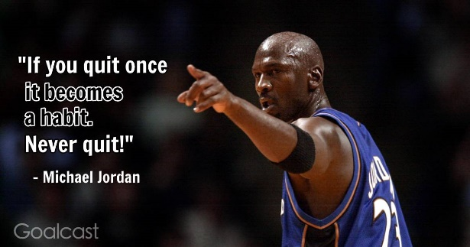
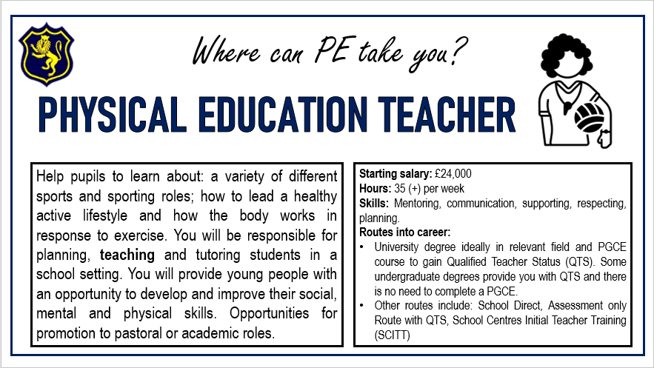
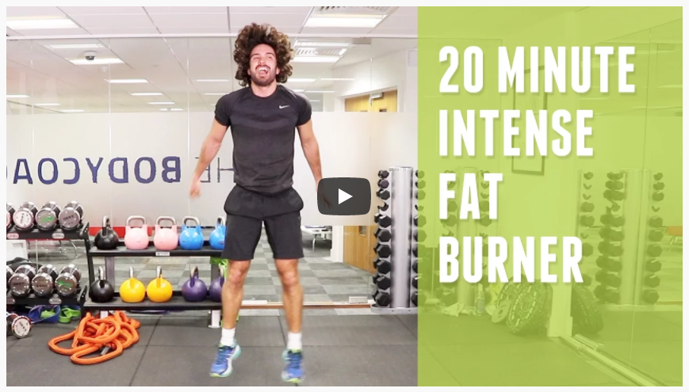
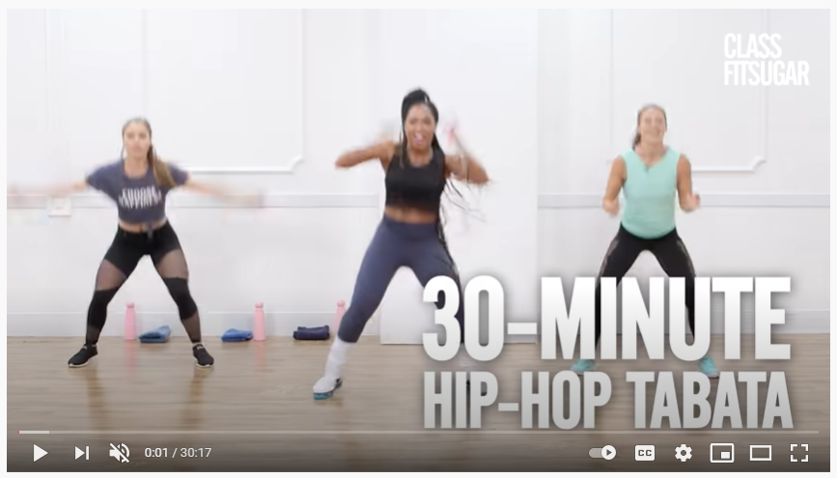
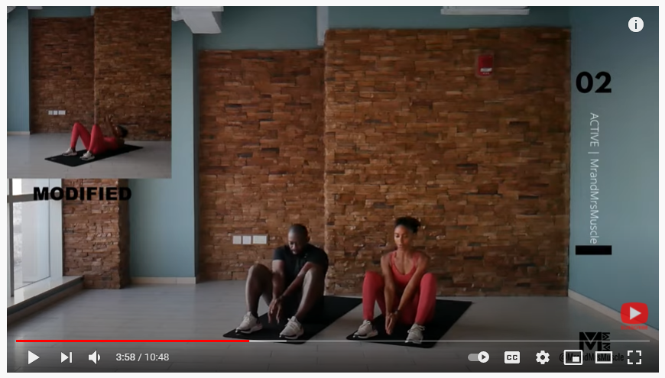
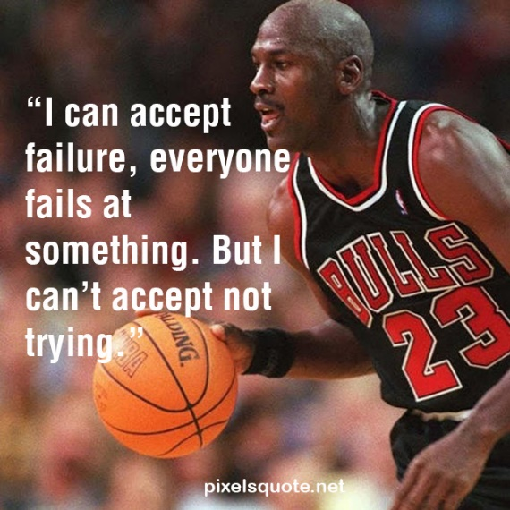
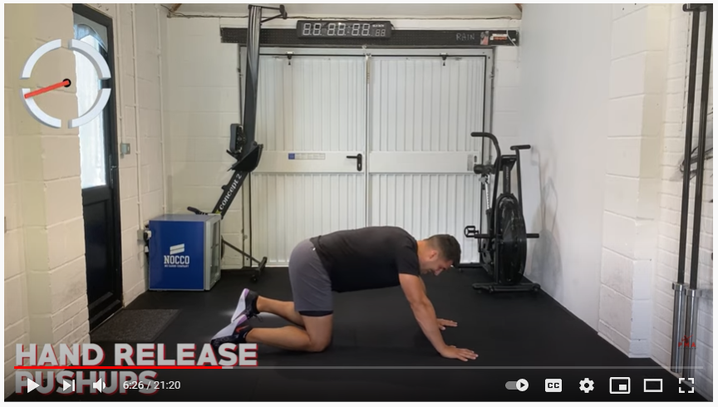
SHS PE NEWSLETTER: ISSUE 1
SPORTING CAREERS (Click on the image for more information)
WORKOUTS OF THE FORTNIGHT
20min HIIT Workout 30min Hip-Hop Workout
No Equipment Abs Workout 20min Full-Body Yoga
20min Bodyweight Workout High School Musical HIIT
JANUARY 2021
PHYSICAL EDUCATION DEPARTMENT

Slide 3
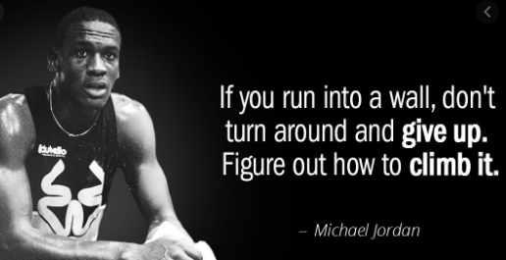
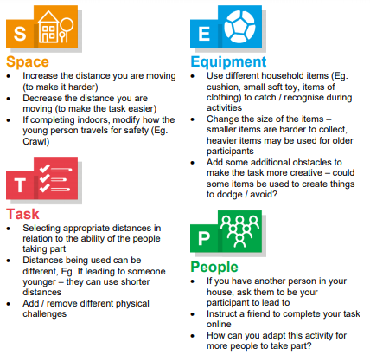
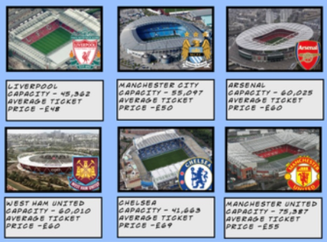
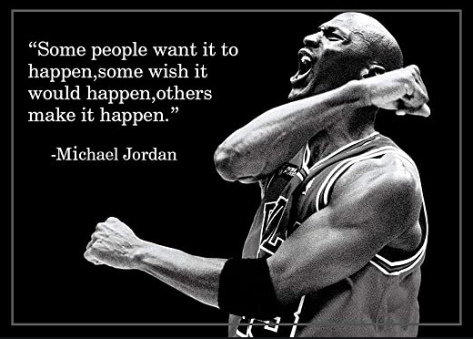
SHS PE NEWSLETTER: ISSUE 1
PE NUMERACY CHALLENGE
Each of these Premier League football clubs can make millions of pounds each year (when fans are allowed in stadiums). Use your multiplication skills to work out the answers to the questions below.
Which clubs earns the MOST per game?
Which club earns the LEAST per game?
SKILL OF THE FORTNIGHT
Dynamic Warm-Up – Watch Video Here
JANUARY 2021
PHYSICAL EDUCATION DEPARTMENT

